Slide 1

Customer Behavior Analysis
Presented by: Group 6

Slide 2

Team
Adaobi Nwachukwu : 0808547
Asif Ahmed : 0823547
Ayushi​ Patel: 0804322
Jaykumar Prakashkumar Prajapati: 0802302
Pavni Bhatt: 0822290

Slide 3


TABLE OF CONTENT
Dataset description
Exploratory Data analysis
Data Visualization
Predictive Modelling Techniques

Slide 4
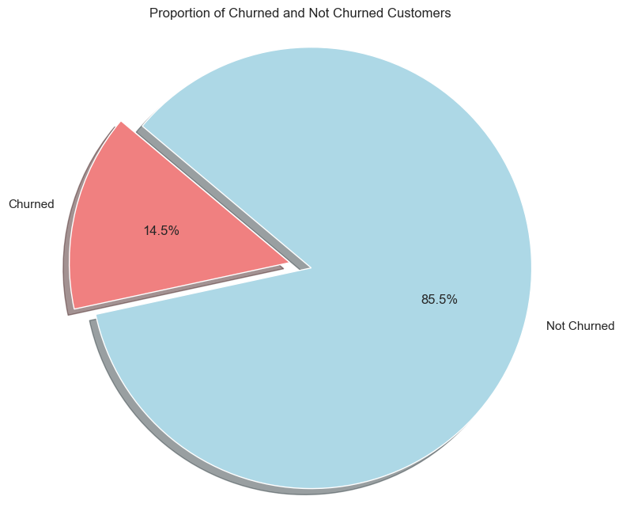
Churn Analysis
Insight:
As the chart shows that 14.5% of the customers have churned and 85.5% of the customers are still using the online store for purchases.
Recommendation:
To retain clients, we have performed Customer segmentation and provided few recommendations for customers who stayed in the upcoming slides.

Slide 5
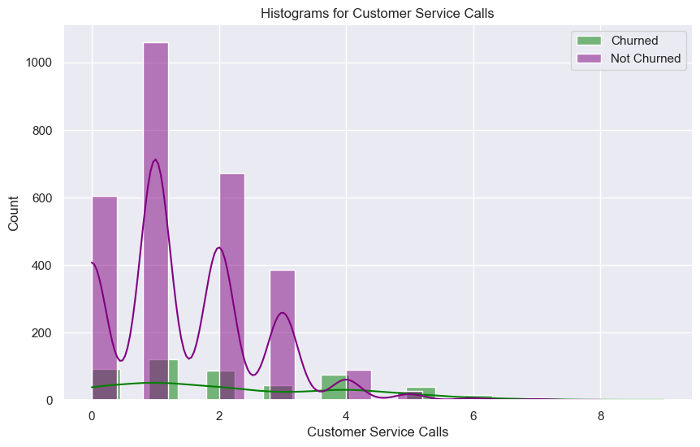
Relationship between Customer Service Call And Customers
Insights:
More than 100 customers who are engaged with the online stores have made at least one service call.
Whereas the number of people who are not associated with the online store anymore have not made as many service calls.
Recommendations:
One interesting insight is that people who have churned made 5 service calls. These people made more calls than those who have not yet churned. They tend to leave if not retained.

Slide 6
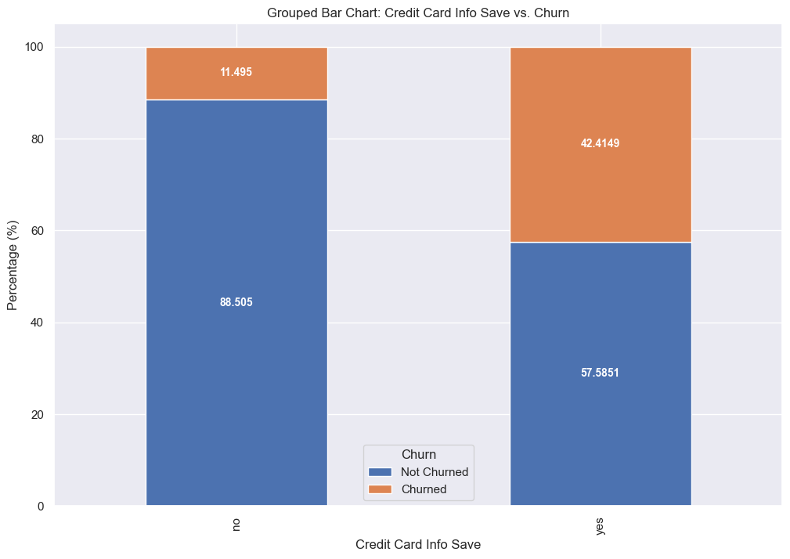
Credit Card Info Save Analysis
Insights:
Most customers do not want to or did not save their credit card info those who have not churned.
Customers who have churned most have saved their credit card info
Recommendations:
Analyze reason behind customer leaving after saving their credit card information.

Slide 7
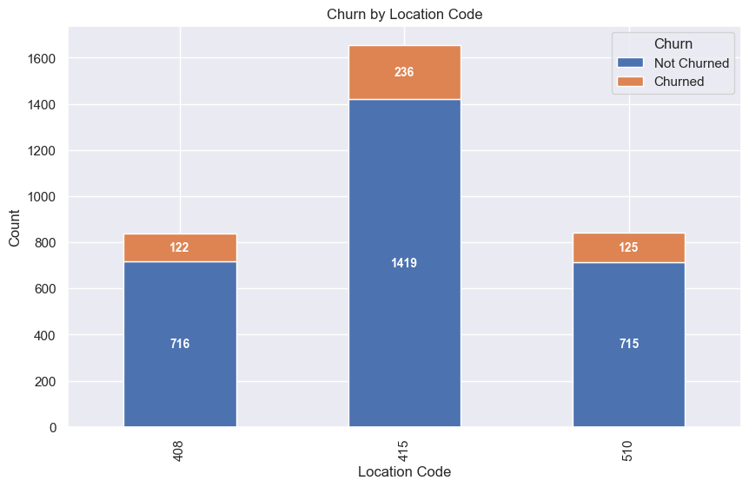
Customer Location Analysis
Insights:
The graph shows location id distributions with respect to customers.
We can see that “415” location id consists of most customers on the online store.
Recommendations:
Focusing on this location to retain more people is beneficial to the online store whereas strategize marketing campaigns towards other locations.

Slide 8
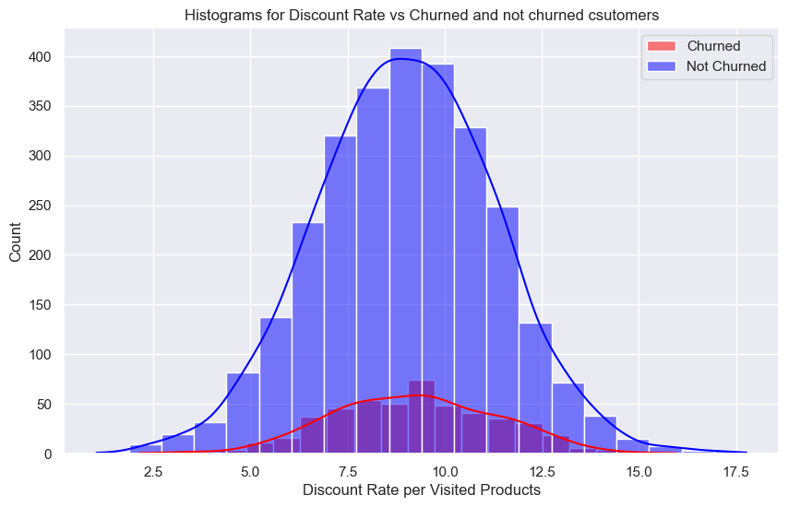
Discount Rate Per Visited Page Analysis
Insights
This histogram represents how many customers have visited discounted products.
We can see that most people have visited products which has around 10% discount.
Recommendations
To retain more customers who tend to visit such products needs to analyze what kind of products they are visiting and provide more products or better deals.

Slide 9
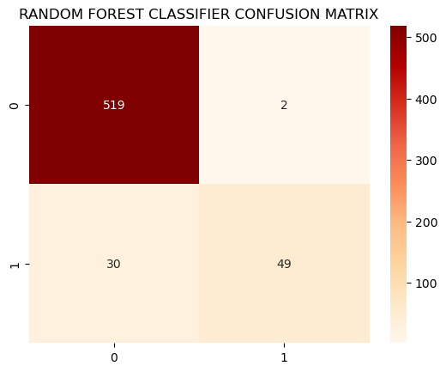
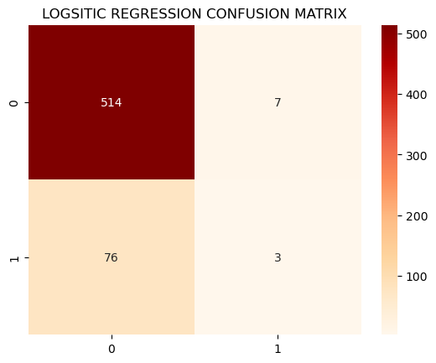
Predictive Modelling Techniques
Machine Learning Models Analysis
We are considering Precision Score as comparing factor between two models because data contains more “not churned” records than “churned” as in any churn data will consists of.
As observed precision score for logistic regression is 62 % which is way lesser than random forest classifier which is 96%.
Which means random forest is better for predicting “churn” datapoints
Model | Accuracy | Churn Precision | Churn Recall
Logistic | 86% | 62% | 10%
Random Forest | 95% | 94% | 74%

Slide 10


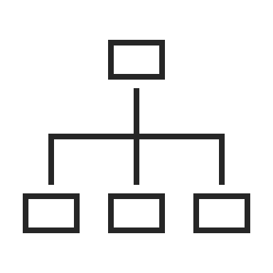
Future Analytics Recommendations
Focusing on location id 415 to retain more customer
Analyze product pages which churned customers are visiting
Use Random Forest model to predict who may leave next

Slide 11
Thank You

